Slide 1
AI

Slide 2
Artificial Intelligence
8.2.7.
Constraint Satisfaction (Ch. 6)

Slide 3
Outline
Definition
Inference
Backtracking search
Local search
The structure of problems
Examples: sudoku, crosswords

Slide 4
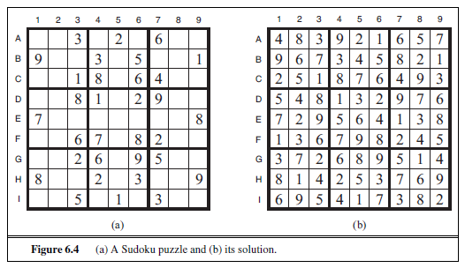
Sudoku

Slide 5
Sudoku

Slide 6
Sudoku Links
http://norvig.com/sudoku.html
http://pythonsudoku.sourceforge.net/
https://pypi.python.org/pypi/sudoku-solver
https://medium.com/towards-data-science/peter-norvigs-sudoku-solver-25779bb349ce
http://www.sudokudragon.com/sudoku.htm
http://www.websudoku.com/

Slide 7
Constraint satisfaction problems (CSPs)
Standard search problem:
state is a "black box“ – any data structure that supports successor function, heuristic function, and goal test
CSP:
state is defined by variables X_{i} with values from domain D_{i}
goal test is a set of constraints specifying allowable combinations of values for subsets of variables
Simple example of a formal representation language
Allows useful general-purpose algorithms with more power than standard search algorithms

Slide 8
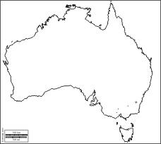
Another foreign trip

Slide 9
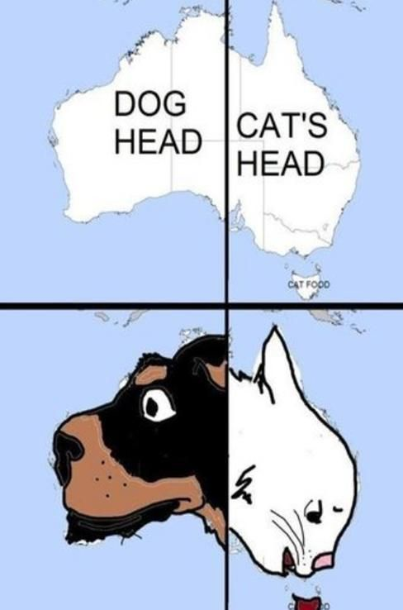

Slide 10
https://imgur.com/7I6Lnk7

Slide 11
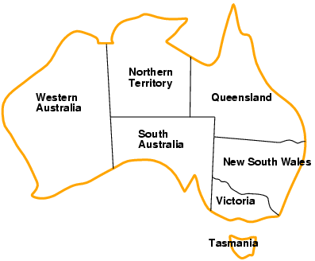
Example: Map Coloring
Variables WA, NT, Q, NSW, V, SA, T
Domains D_{i} = {red,green,blue}
Constraints: adjacent regions must have different colors
e.g., WA ≠ NT, or (WA,NT) in {(red,green),(red,blue),(green,red), (green,blue),(blue,red),(blue,green)}

Slide 12
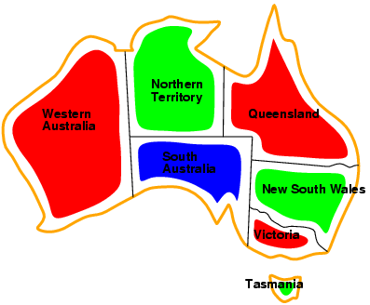
Example: Map Coloring
Solutions are complete and consistent assignments, e.g., WA = red, NT = green,Q = red,NSW = green,V = red,SA = blue,T = green

Slide 13
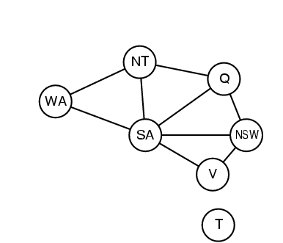
Constraint graph
Binary CSP: each constraint relates two variables
Constraint graph: nodes are variables, arcs are constraints

Slide 14
Varieties of CSPs
Discrete variables
finite domains:
n variables, domain size d → O(d^{n}) complete assignments
e.g., Boolean CSPs, incl.~Boolean satisfiability (NP-complete)
infinite domains:
integers, strings, etc.
e.g., job scheduling, variables are start/end days for each job
need a constraint language, e.g., StartJob₁ + 5 ≤ StartJob₃
Continuous variables
e.g., start/end times for Hubble Space Telescope observations
linear constraints solvable in polynomial time by linear programming

Slide 15
Varieties of constraints
Unary constraints involve a single variable,
e.g., SA ≠ green
Binary constraints involve pairs of variables,
e.g., SA ≠ WA
Higher-order constraints involve 3 or more variables,
e.g., cryptarithmetic column constraints

Slide 16
Puzzle
T W O
+ T W O
-------
F O U R

Slide 17
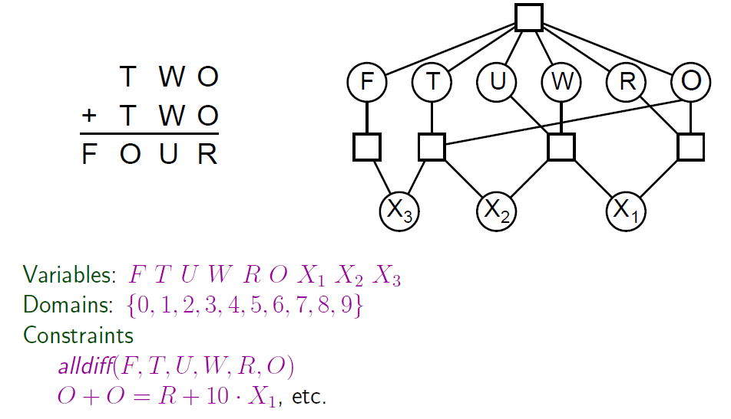
Example: Cryptarithmetic

Slide 18
Solution
734+734=1468

Slide 19
Real-world CSPs
Assignment problems
e.g., who teaches what class
Timetabling problems
e.g., which class is offered when and where?
Transportation scheduling
Factory scheduling
Circuit layout
Notice that many real-world problems involve real-valued variables

Slide 20
State-based models
State:
Keeps track of the relevant information so far, that is needed to find an optimal solution
Search problem
Min-cost path
Tree-based algorithms
Backtracking
Graph-based algorithms
Dynamic Programming
Uniform Cost Search
A*

Slide 21
Standard search formulation (incremental)
Let's start with the straightforward approach, then fix it
States are defined by the values assigned so far
Initial state: the empty assignment { }
Successor function: assign a value to an unassigned variable that does not conflict with current assignment
→ fail if no legal assignments
Goal test: the current assignment is complete
This is the same for all CSPs
Every solution appears at depth n with n variables → use depth-first search
Path is irrelevant, so can also use complete-state formulation
b = (n - l )d at depth l, hence n! · d^{n} leaves

Slide 22
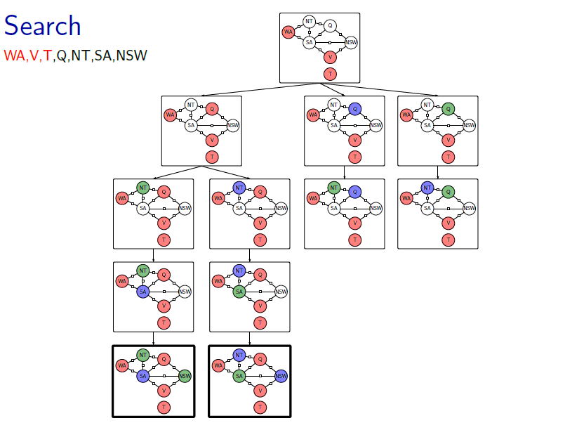
[Slide from Percy Liang]

Slide 23
Backtracking search
Variable assignments are commutative, i.e.,
[ WA = red then NT = green ] same as [ NT = green then WA = red ]
Only need to consider assignments to a single variable at each node
→ b = d and there are d^{n} leaves
Depth-first search for CSPs with single-variable assignments is called backtracking search
Backtracking search is the basic uninformed algorithm for CSPs
Can solve n-queens for n ≈ 25

Slide 24
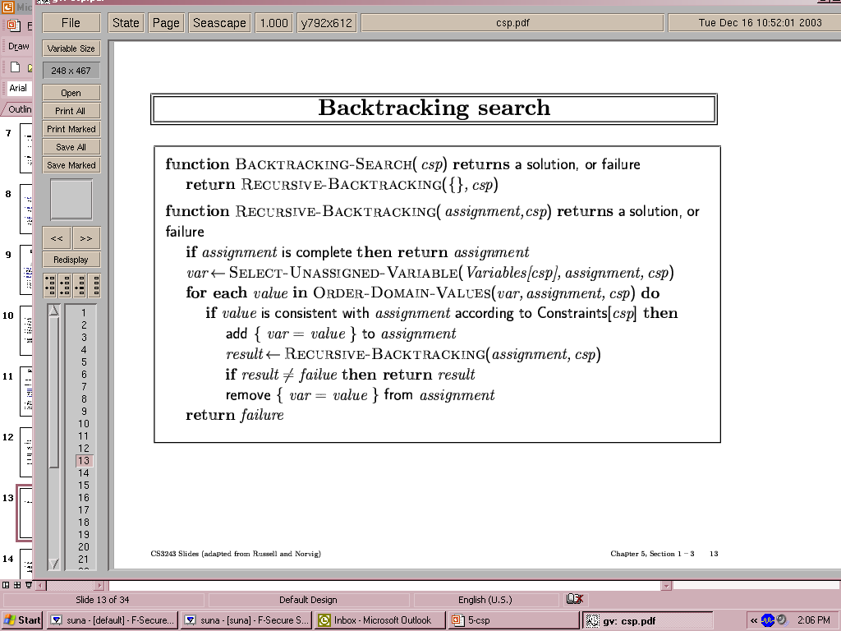
Backtracking search

Slide 25

Backtracking example

Slide 26
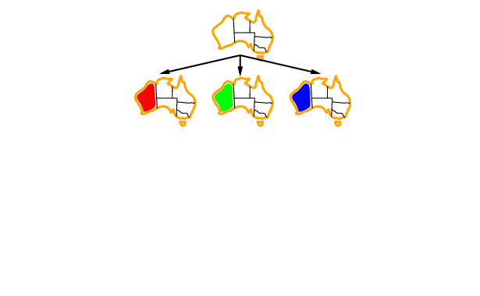
Backtracking example

Slide 27
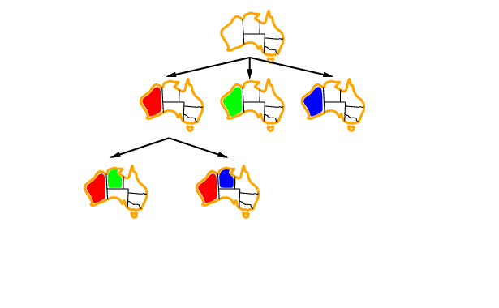
Backtracking example

Slide 28
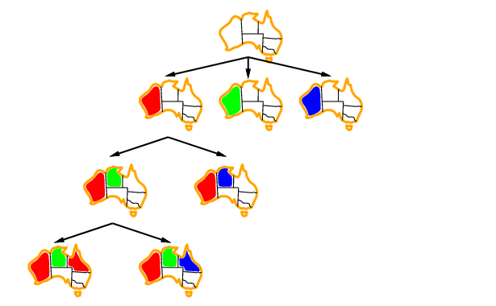
Backtracking example

Slide 29
Improving backtracking efficiency
General-purpose methods can give huge gains in speed:
Which variable should be assigned next?
In what order should its values be tried?
Can we detect inevitable failure early?

Slide 30

Most constrained variable
Most constrained variable:
choose the variable with the fewest legal values
a.k.a. minimum remaining values (MRV) heuristic

Slide 31

Most constraining variable
Tie-breaker among most constrained variables
Most constraining variable:
choose the variable with the most constraints on remaining variables

Slide 32
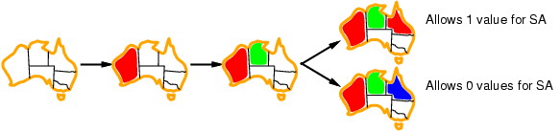
Least constraining value
Given a variable, choose the least constraining value:
the one that rules out the fewest values in the remaining variables
Combining these heuristics makes 1000 queens feasible

Slide 33
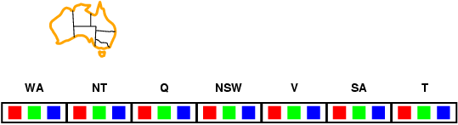
Forward checking
Idea:
Keep track of remaining legal values for unassigned variables
Terminate search when any variable has no legal values

Slide 34
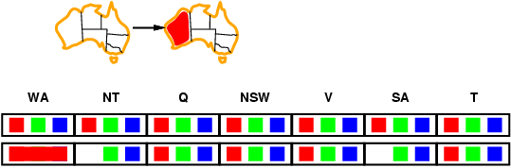
Forward checking
Idea:
Keep track of remaining legal values for unassigned variables
Terminate search when any variable has no legal values

Slide 35
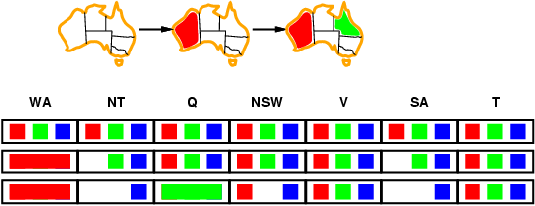
Forward checking
Idea:
Keep track of remaining legal values for unassigned variables
Terminate search when any variable has no legal values

Slide 36
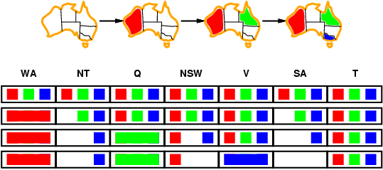
Forward checking
Idea:
Keep track of remaining legal values for unassigned variables
Terminate search when any variable has no legal values

Slide 37
Constraint propagation
Forward checking propagates information from assigned to unassigned variables, but doesn't provide early detection for all failures:
NT and SA cannot both be blue!
Constraint propagation repeatedly enforces constraints locally

Slide 38
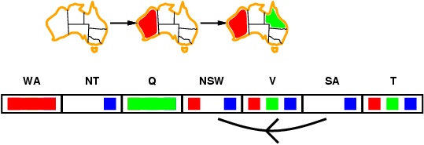
Arc consistency
Simplest form of propagation makes each arc consistent
X →Y is consistent iff
for every value x of X there is some allowed y

Slide 39
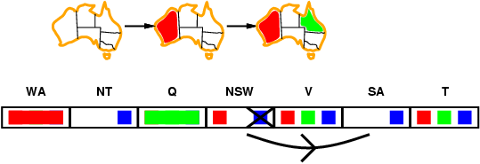
Arc consistency
Simplest form of propagation makes each arc consistent
X →Y is consistent iff
for every value x of X there is some allowed y

Slide 40
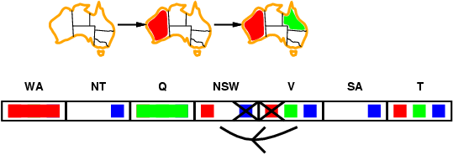
Arc consistency
Simplest form of propagation makes each arc consistent
X →Y is consistent iff
for every value x of X there is some allowed y
If X loses a value, neighbors of X need to be rechecked

Slide 41
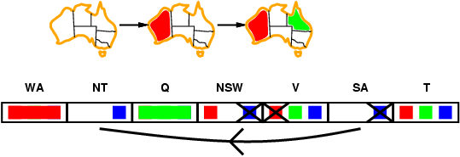
Arc consistency
Simplest form of propagation makes each arc consistent
X →Y is consistent iff
for every value x of X there is some allowed y
If X loses a value, neighbors of X need to be rechecked
Arc consistency detects failure earlier than forward checking
Can be run as a preprocessor or after each assignment

Slide 42
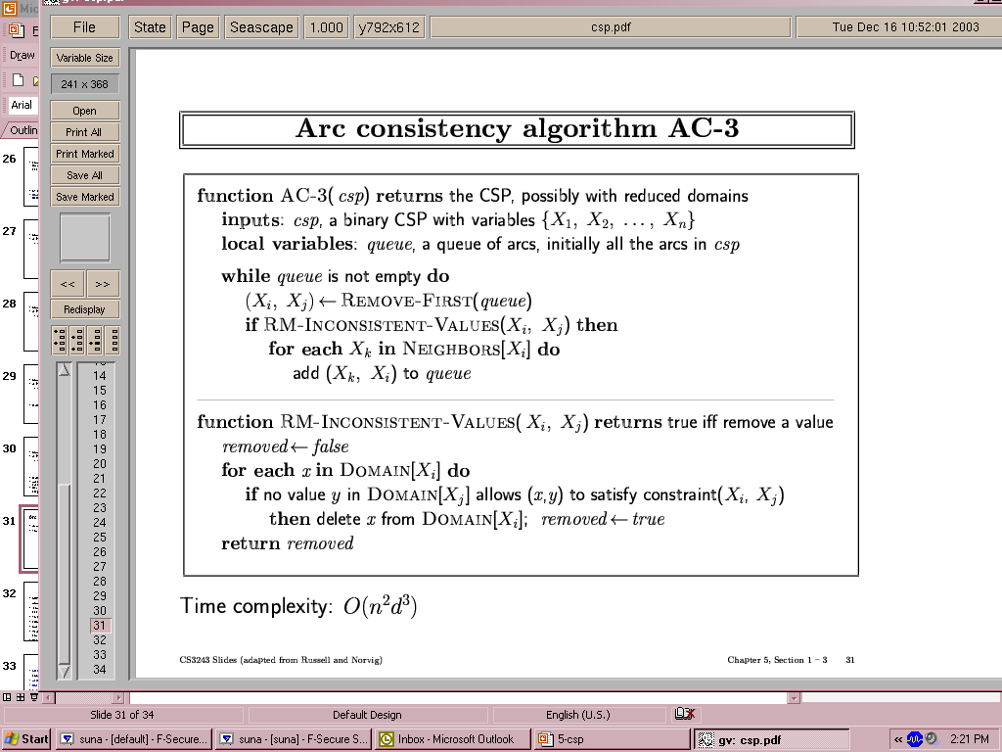
Arc consistency algorithm AC-3
Time complexity: O(n²d³)

Slide 43
Local search for CSPs
Hill-climbing, simulated annealing typically work with "complete" states, i.e., all variables assigned
To apply to CSPs:
allow states with unsatisfied constraints
operators reassign variable values
Variable selection: randomly select any conflicted variable
Value selection by min-conflicts heuristic:
choose value that violates the fewest constraints
i.e., hill-climb with h(n) = total number of violated constraints

Slide 44
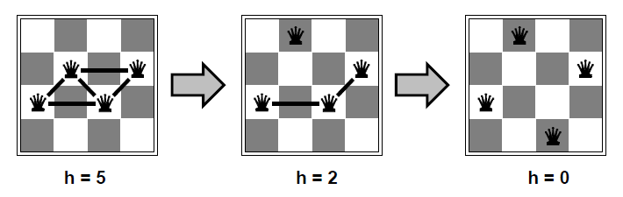
Example: 4-Queens
States: 4 queens in 4 columns (4⁴ = 256 states)
Actions: move queen in column
Goal test: no attacks
Evaluation: h(n) = number of attacks
Given random initial state, can solve n-queens in almost constant time for arbitrary n with high probability (e.g., n = 10,000,000)

Slide 45
Example: 4-Queens Problem
X1
X2
X3
X4
X1
{1,2,3,4}
X2
{1,2,3,4}
1
2
3
4
X3
{1,2,3,4}
X4
{1,2,3,4}
(Slides from Bonnie Dorr)

Slide 46
Example: 4-Queens Problem
1
2
3
4
X1
{1,2,3,4}
X2
{1,2,3,4}
1
2
3
4
X3
{1,2,3,4}
X4
{1,2,3,4}

Slide 47
Example: 4-Queens Problem
1
2
3
4
X1
{1,2,3,4}
X2
{ , ,3,4}
1
2
3
4
X3
{ ,2, ,4}
X4
{ ,2,3, }

Slide 48
Example: 4-Queens Problem
1
2
3
4
X1
{1,2,3,4}
X2
{ , ,3,4}
1
2
3
4
X3
{ ,2, ,4}
X4
{ ,2,3, }

Slide 49
Example: 4-Queens Problem
1
2
3
4
X1
{1,2,3,4}
X2
{ , ,3,4}
1
2
3
Backtrack!!!
4
X3
{ , , , }
X4
{ ,2,3, }

Slide 50
Example: 4-Queens Problem
Picking up a little later after two steps of backtracking….
1
2
3
4
X1
{ ,2,3,4}
X2
{1,2,3,4}
1
2
3
4
X3
{1,2,3,4}
X4
{1,2,3,4}

Slide 51
Example: 4-Queens Problem
1
2
3
4
X1
{ ,2,3,4}
X2
{ , , ,4}
1
2
3
4
X3
{1, ,3, }
X4
{1, ,3,4}

Slide 52
Example: 4-Queens Problem
1
2
3
4
X1
{ ,2,3,4}
X2
{ , , ,4}
1
2
3
4
X3
{1, ,3, }
X4
{1, ,3,4}

Slide 53
Example: 4-Queens Problem
1
2
3
4
X1
{ ,2,3,4}
X2
{ , , ,4}
1
2
3
4
X3
{1, , , }
X4
{1, ,3, }

Slide 54
Example: 4-Queens Problem
1
2
3
4
X1
{ ,2,3,4}
X2
{ , , ,4}
1
2
3
4
X3
{1, , , }
X4
{1, ,3, }

Slide 55
Example: 4-Queens Problem
1
2
3
4
X1
{ ,2,3,4}
X2
{ , , ,4}
1
2
3
4
X3
{1, , , }
X4
{ , ,3, }

Slide 56
Example: 4-Queens Problem
1
2
3
4
X1
{ ,2,3,4}
X2
{ , , ,4}
1
2
3
4
X3
{1, , , }
X4
{ , ,3, }

Slide 57
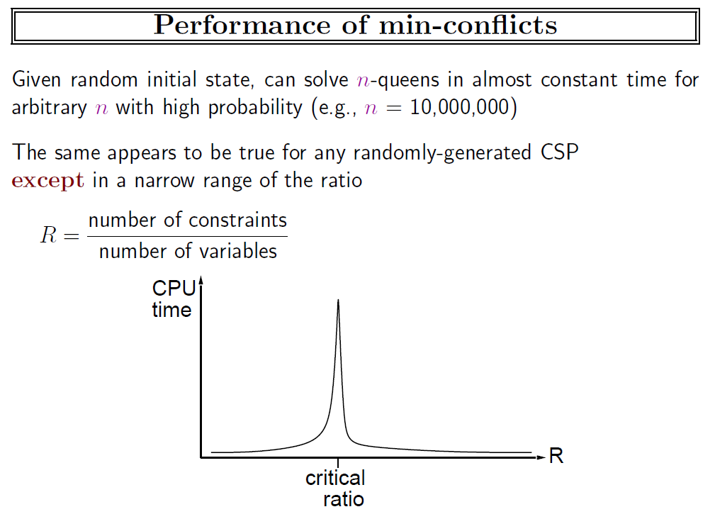

Slide 58
Simple csp example
vars=['Alex','Bob'] # We will define our vars to be undergrads, Alex and Bob
domains={'Alex':[1,2,3,4],'Bob':[1,2,3,4]} # Alex and Bob are both in year 1...4
neighbors={'Alex':['Bob'],'Bob':['Alex']} # Specify that Alex is affected by Bob & vice versa
def constraints(A, a, B, b): # Constraint: Alex is 3 years ahead of Bob
# Fail if Alex isn't 3 years ahead of Bob
if (A=='Alex' and B=='Bob' and a - b <> 3):
return False
# Fail if Bob isn't 3 years behind Alex
# (nb: we cover all possible input with logical consistency)
if (B=='Alex' and A =='Bob' and b - a <> 3):
return False
return True
csp=CSP(vars, domains, neighbors, constraints) # Get a CSP object that defines this problem
assignments=min_conflicts(csp) # Solve the CSP with the min conflicts algorithm
print assignments # Should observe that Bob: 1 Alex: 4
Example by Andrew Mercer-Taylor

Slide 59
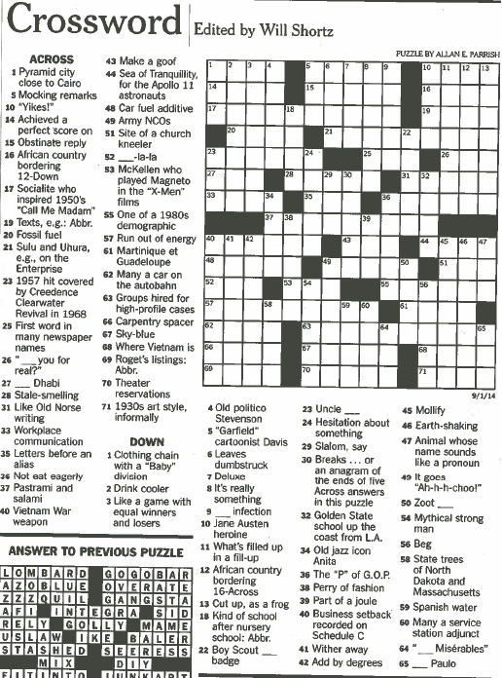

Slide 60
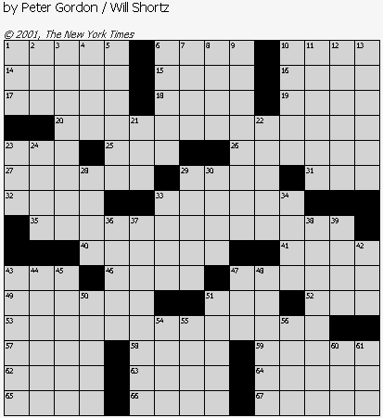
Crossword puzzles

Slide 61
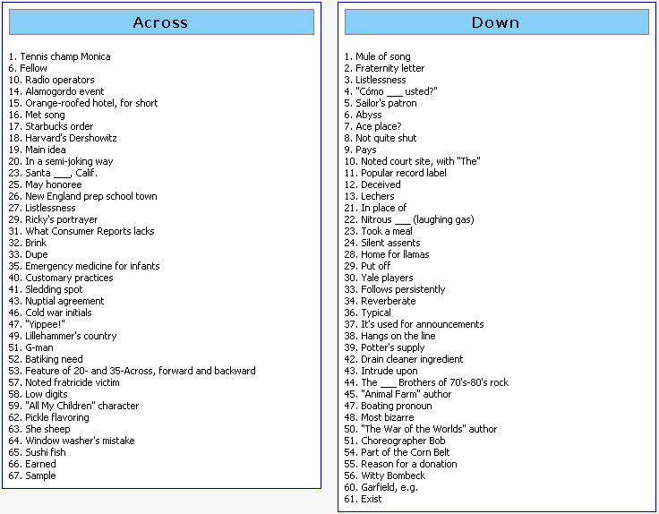

Slide 62
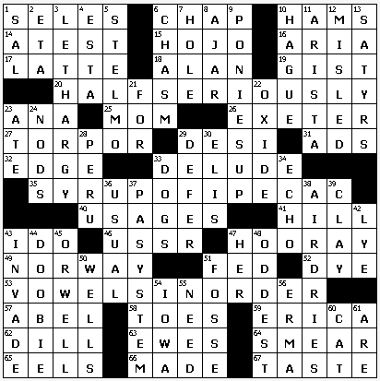

Slide 63
Word 1
Sense 1
It has bark but no bite
Its bark is silent
Sense 2
Branch location
Sense 3
Fort locale
Type of house
House for kids
Sense 4
Lineage display
Every family has one
Family chart
Sense 5
Cobbler’s need
Shoe stretcher
Others
It leaves in the spring
Where to get dates
Site of many a cat rescue
Dendrophobe’s fear
Forbidden fruit source
Golf-course obstacle
Ring holder
Leaves home
Newspaper source
K-I-S-S-I-N-G place
TREE

Slide 64
Words 2 and 3
Sense 1
Flood survivor
Ararat lander
Rider of the lost ark
Biblical helmsman
Guy who believed in “take two”
Noted couples protector
Early matchmaker
Captain of a famous cruise for couples
Life preserver
Person known for double takes
Sense 2
First name in lexicography
One of the Websters
Sense 3
Actor Wyle
Sense 1
Houston Colt 45 today
Enron Field player, once
Houston player
Texas leaguer
Nolan Ryan, notably
2005 world series participant
Player under a dome
Pirate battler, at times
Sense 2
Cartoon dog
Space age hound
Jetson canine
Animated pooch
Elroy’s pet
Sense 3
Bygone Chevrolet van
NOAH
ASTRO

Slide 65
Evaluation
PHIL..SCUBA.IMP PHIL..SCUBA.IMP
OEA-O.NANAS.DOE OUTED.NANAS.DOE
WRM-SR-BBIT.ORE WHITERABBIT.ORE
..IMOUT.ROOSTER ..SUNUP.ROOSTER
GASP.ITNO..AONE GASP.ITNO..AONE
ETA.KNOCKONWOOD ETA.KNOCKONWOOD
AMISH..RELAY... AMISH..RELAY...
REDCAPS.NANETTE REDCAPS.NANETTE
...OKIES..CREED ...OKIES..CREED
AMERICANPIE.LAD AMERICANPIE.LAD
NAVE..WOOL.ALLY NAVE..WOOL.ALLY
ICEDTEA.RETRO.. ICEDTEA.TETRA..
MAN.SILVERBELLS MAN.SILVERBELLS
AWE.ARLEN.ANITA AWE.ARLEN.ANITA
LSD.RESET..AERO LSD.RESET..AERO

Slide 66
Crossword clues
Pyramid city close to Cairo (4)
__ Dhabi (3)
McKellen who plays Magneto in the “X-Men” franchise (3)
Martinique et Guadeloupe (4)
Many a car on the Autobahn (4)
Mythical strong man (5)

Slide 67
Crossword clues
19th out of 24 (3) TAU
The continents, e.g., (6) SEPTET
Made bats (9) DRIVENMAD
Runners in the cold (5) NOSES
Quit stalling (7) DOITNOW
Oktoberfest quaff (4) BIER
Out-of-the way way (6) DETOUR
Rubber from Arabia (7) ALADDIN
One inspiring love of poetry (5) ERATO
Lab report (3) ARF
Year John Dryden died (4) MDCC
One spinning one's wheels (6) POTTER
It's bigger than a family (5) ORDER
Some loaves (4) RYES
The Beatles' "P.S. I Love You", e.g. (5) BSIDE
Maximally hip (7) COOLEST

Slide 68
Crossword clues
Early third-century year (4) CCIV
When the day's done, to Denis (4) NUIT
Cover with new shingles (6) REROOF
Puncture preceder (3) ACU
Suffix with miss and dismiss (3) IVE
Nurse (3) SIP
Politician with a like button? (3) IKE
Beyond piqued (5) ANGRY
Ones trapped in boxes of their own making? (5) MIMES
Quince, e.g., (6) NUMERO
"Celeste Aida," for one (4) ARIA
Take a shot? (6) IMBIBE
Long sentence (4) LIFE
Hyundai and Kia (5) AUTOS
Suffix with shepherd (3) ESS
"Thank you," in Hawaii (6) MAHALO

Slide 69
Crossword clues
2,502, to ancient Romans (5) MMDII
___ Beach, S.C. (6) MYRTLE
Sierra ___ (5) LEONE
Canoodling in a restaurant, e.g. (abbr.) (3) PDA
New Orleans-to-Detroit dir. (3) NNE
Harry Potter's Hedwig, e.g., (3) OWL
Mothers with pride? (9) LIONESSES
Platinum, for example (5) METAL
Work undercover, in a way (3) SPY
Helper, in brief (4) ASST
Intro to physics? (4) META
Cronus and Hyperion (6) TITANS
Shrek or Fiona (5) OGRES
Electrican, often (5) WIRER
Lion, sometimes (6) ROARER

Slide 70
Crossword clues
Plasm preceder (4) ECTO
Prefix with scope (6) STETHO
Overshoot, say (4) MISS
Gait (4) PACE
Medical suffix (3) OMA
Fox tail? (4) TROT
Honda model (6) ACCORD
What losses do to fans (6) SADDEN
Largest city in Nebraska (5) OMAHA
"Owner of a Lonely Heart" band (3) YES
Fire antonym (4) HIRE
Chemists' org (3) AIC
"Titanic actor Billy (4) ZANE
Former South African president (5) BOTHA

Slide 71
Constraint Satisfaction Problem
(X, D, C)
X is set of variables = (X₁, … , X_{k})
D is set of domains = (D₁, … , D_{k})
Each D_{i} is set of allowed values for X_{i}
C is set of constraints
C_{i} = <participants, relation>
Example by Steven Wilson

Slide 72
For the Crosswords Problem
(X, D, C)
X is the set of entries that must be filled
D is set of candidate answers
C enforces intersections
D₁=
FRODO,
MERRY,
GOLUM
X₁
D₂=
DRAW,
FIRE,
SHOT
X₂
C = ( <X₁,X₂>,
X₁[1]=X₂[1] OR X₁[1]=“” OR X₂[1]=“”)

Slide 73
Minimum Conflicts Heuristic
Choose v ϵ D_{i} with lowest number of conflicts
Otherwise randomly
Continue to reassign conflicted variables
D₁=
FRODO,
MERRY,
GOLUM
X₁
D₂=
DRAW,
FIRE,
SHOT
F
X₂
R
O
C = ( <X₁,X₂>,
X₁[1]=X₂[1] OR X₁[1]=“” OR X₂[1]=“”)
D
O

Slide 74
What to do with conflicts?
Back off one answer at a time
Choose x = answer with lowest ranking
Set x to blank
Repeat until no conflicts left

Slide 75
A crossword puzzle CSP
Variables: the entries of the puzzle (“1A”, etc).
Domains: possible words for an entry. Generated by NLP components.
Neighbors: entries sharing an intersection.
Constraint: entries that share an intersection must have the same letter in that intersection.
Example by Andrew Mercer-Taylor

Slide 76
Solving the crossword puzzle
Initially, all entries are set to “-”*, which indicates missing values. This means our CSP is technically solved from the beginning.
Instead of looking for a solution that just fulfills the constraints, we search for one that maximizes the likelihood of the words.
Every candidate word has some score reflecting how likely it is for the given clue. These are provided by the NLP components.

Slide 77
Dr. Fill Procedure 6.4
Given a crossword puzzle CSP, a partial solution S, best solution so far B, and previously pitched assignments P:
solve(CSP, S, B, P):
if S assigns every variable, return B or S, whichever is better
S' ← S with the addition of the most likely assignment not in P to an unassigned variable
CSP' ← propagate(CSP, S')
if propagation succeeded, B ← solve(CSP', S', B, P)
if P contains all values, return B
P' ← P with the addition of the assignment we tried in S'
B ← solve(CSP, S, B, P')

Slide 78
Postprocessing
In practice, this algorithm results in many cases where a single letter is missing. We therefore perform the following postprocessing procedure:
incompleteEntries ← a list of entries with missing letters, ordered by the number of letters missing
for entry e in incompleteEntries:
w ← a word that matches the length and the existing letters of entry, None if none found
if w is not None, assign e to w

Slide 79
1 |  | 2
3
Across:
1) Man's best friend
3) Application format
Down:
1) To be paid
2) ETS exam
Variable | Domain (ranked by score)
1A | DOG, PET, PAL
1D | DUE, IOU, FEE, OWE, PRO
2D | SAT, GRE
3A | DLL, EXE, BAT, MSI, ZIP, SYS

Slide 80
1 |  | 2
3
Across:
1) Man's best friend
3) Application format
Down:
1) To be paid
2) ETS exam
Variable | Domain (ranked by score)
1A | DOG, PET, PAL
1D | DUE, IOU, FEE, OWE, PRO
2D | SAT, GRE
3A | DLL, EXE, BAT, MSI, ZIP, SYS
1 D | O | 2 G
U |  | R
3 E | X | E

Slide 81
Solving a crossword CSP
Instead of looking for a solution that just fulfills the constraints, we search for one that maximizes the likelihood of the words.
Every candidate word has some score reflecting how likely it is for the given clue. These are provided by the NLP components.

Slide 82
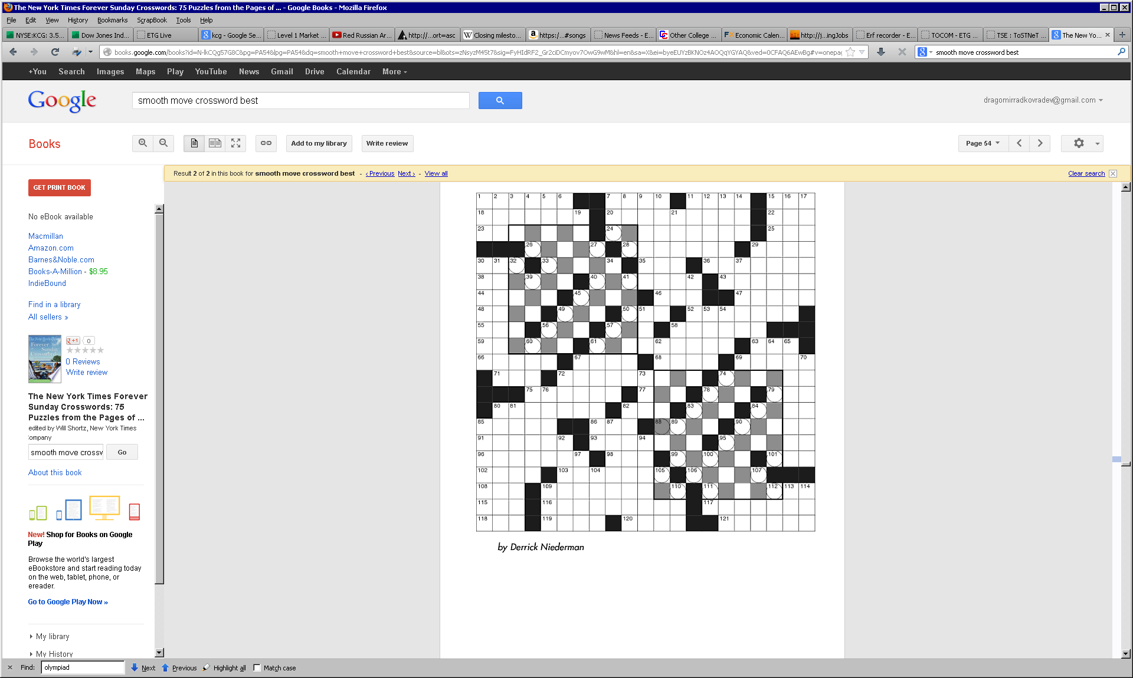

Slide 83
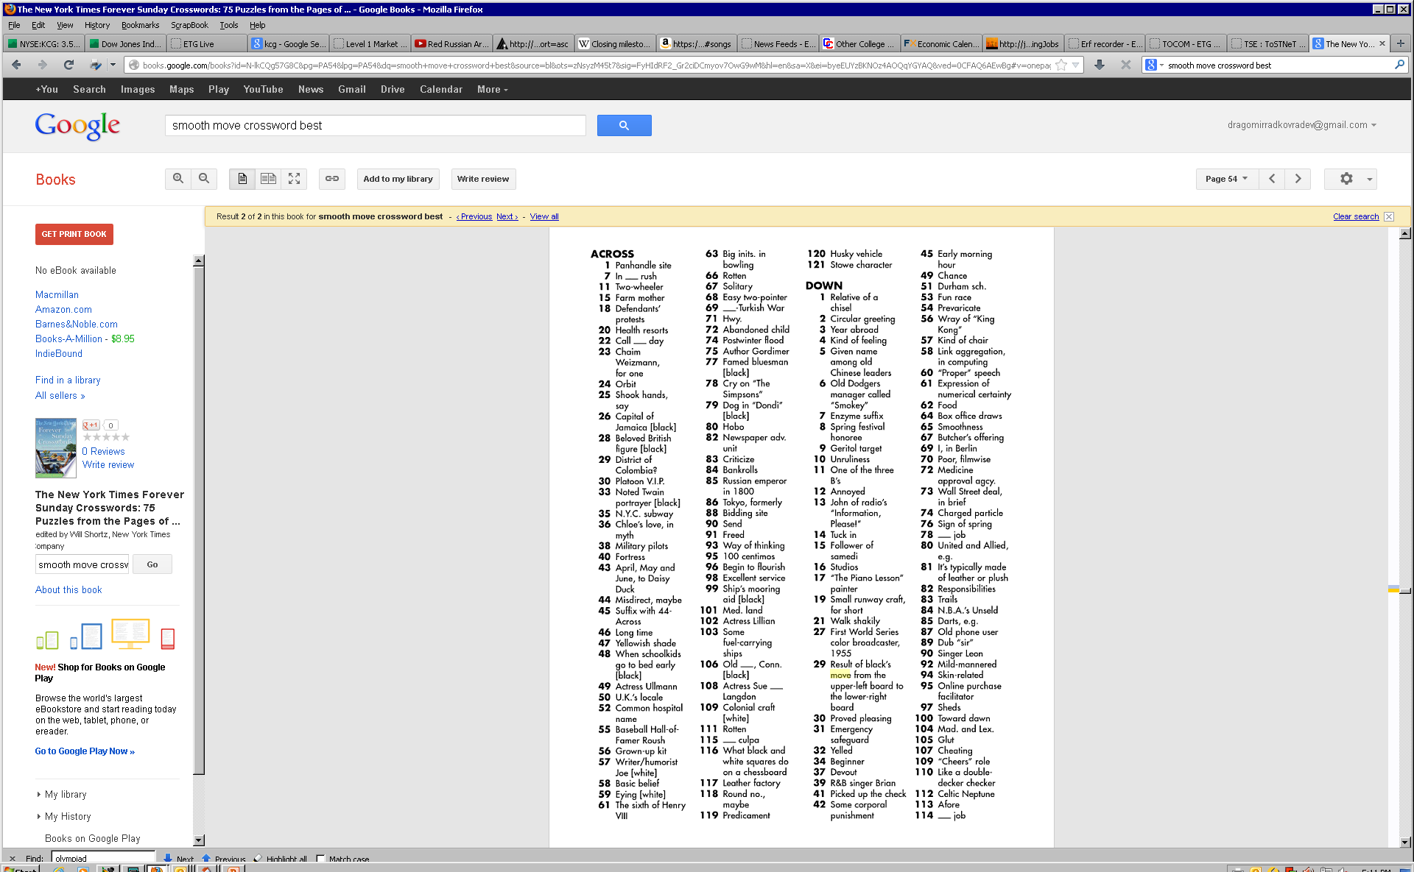

Slide 84
Crossword puzzles
OneAcross – Littman
Dr. Fill – Ginsberg
Our corpus
174,641 words with 1,692,482 clues
Highest density words:
Ear: 1808 clues
Sea: 1707 clues
Tree: 1578 clues
Era: 1578 clues
Aria: 1428 clues
….

Slide 85
Generated Actual Solution
LASERBEAM.IDOLS CLICKBAIT.ANGST
E---RO--E.RAMOS HENRIETTA.NORAH
AUSTRALIA.ESTER INSOMNIAC.DRIVE
DOIN..ELLEN.TAB RAPS..MLKJR.NAB
EOOYLOU..BETSEY APOSTLE..LEANNE
R---OP.RUE.NINA CETERA.AGO.NINA
...-PUSI-.JONAS ...DOTTIE.JONAS
MOVIESTOOKSIXTY FIVETHIRTYEIGHT
AGNES.EJ----... ADAYS.RESEWN...
NINE.RPA.LOOSES CORE.RED.LETSAT
TENANT..ALLENDE ENDSIT..ALLENDE
INN.AELSS..ISEE STA.KELPS..DAVE
L--LF.OHTEA---- OLLIE.OUTSPOKEN
L--ET.SORNC---- FIONA.STRAINERS
ARENA.STODE---- FESTS.STOPPEDBY

Slide 86
Components

Slide 87
1 Missing last name
Titanic actor Billy (4) ZANE
James who wrote "A Death in the Family" (4) AGEE
Cesar who played the Joker (6) ROMERO
Cheri formerly of "S.N.L." (5) OTERI
2 Missing first name
“Wrecking Ball" singer Cyrus (5) MILEY
Playwright O'Neill (6) EUGENE
Stuntman Knievel (4) EVEL
"Morning Joe" co-host Brzezinski (4) MIKA
Yiddish author Aleichem (6) SHOLOM
3 Roman years
Year John Dryden died (4) MDCC
Early third-century year (4) CCIV
2,502, to ancient Romans (5) MMDII
4 Common French words
When the day's done, to Denis (4) NUIT

Slide 88
5 Prefix
Puncture preceder (3) ACU
Intro to physics? (4) META
Plasm preceder (4) ECTO
Prefix with scope (6) STETHO
6 Suffix
Suffix with miss and dismiss (3) IVE
Suffix with shepherd (3) ESS
Medical suffix (3) OMA
Fox tail? (4) TROT
7 Direction
New Orleans-to-Detroit dir. (3) NNE
8 World capitals
Samoa's capital (4) APIA
9 Common French words
Black: Fr. (4) NOIR
Mrs., in Marseille (3) MME

Slide 89
10 Common German words
11 Common Spanish words
12 Common Portuguese, Italian, Hawaiian, etc. words
"Thank you," in Hawaii (6) MAHALO
13 Brands
Hyundai and Kia (5) AUTOS
14 Competitors
Marriott alternative (4) OMNI
15 Acronym
Canoodling in a restaurant, e.g. (abbr.) (3) PDA
Chemists' org (3) AIC
16 Hypernym
Platinum, for example (5) METAL
Cronus and Hyperion (6) TITANS

Slide 90
17 Synonym
Overshoot, say (4) MISS
Gait (4) PACE
18 Roles
1963 Elizabeth Taylor role (9) CLEOPATRA
19 Products
Honda model (6) ACCORD
20 Cities
Largest city in Nebraska (5) OMAHA
21 Songs and performers
"Owner of a Lonely Heart" band (3) YES
22 Famous person
Former South African president (5) BOTHA
23 Partner
Gentleman's partner (4) LADY

Slide 91
24 Dictionary Definitions
Coffee dispenser (3) URN
25 Two+ word phrases
On task (4) ATIT
Drink a little here, drink a little there... (6) BARHOP
Went without a copilot (8) FLEWSOLO
An operator may help place one (9) PHONECALL
Flown into a rage (13) GONEBALLISTIC
Wine-producing area of SE France (11) RHONEVALLEY
Food, warmth or a cozy bed (15) CREATURECOMFORT
Money available for nonessentials (9) SPARECASH
26 Counterpart
Bull's counterpart (4) BEAR

Slide 92
27 Alternative
Reebok alternative (4) NIKE
28 Musical key
Key of Mozart's Symphony No. 40 (6) GMINOR
29 Movies
Tom Cruise film set in Chicago (13) RISKYBUSINESS
30 Co-star
Tom Cruise's 'Risky Business' co-star (15) REBECCADEMORNAY
31 Characters
Judy's brother on the Jetsons (5) ELROY
32 Fill in the blank (for parts of names or words, rather than phrases in general)
___ Beach, S.C. (6) MYRTLE
Boston ___ Party (3) TEA

Slide 93
What is a DOG?
272 definitions!

Slide 94
Utter failure, in slang crosswordheaven.com/clues/utter-failure-in-slang
Track crosswordheaven.com/clues/track
Follow crosswordheaven.com/clues/follow
Dyslexic's deity? crosswordheaven.com/clues/dyslexics-deity
Greyhound, e.g. crosswordheaven.com/clues/greyhound-eg
Pluto, for one crosswordheaven.com/clues/pluto-for-one
Mexican hairless, for one crosswordheaven.com/clues/mexican-hairless-for-one
It's found in a pound crosswordheaven.com/clues/its-found-in-a-pound
Terrier or retriever crosswordheaven.com/clues/terrier-or-retriever
One may sit for a master crosswordheaven.com/clues/one-may-sit-for-a-master
Tail crosswordheaven.com/clues/tail
Frank crosswordheaven.com/clues/frank
Pug or boxer crosswordheaven.com/clues/pug-or-boxer
"Man's best friend" crosswordheaven.com/clues/mans-best-friend
Puggle, e.g. crosswordheaven.com/clues/puggle-eg
Pointer, e.g. crosswordheaven.com/clues/pointer-eg
Follow relentlessly crosswordheaven.com/clues/follow-relentlessly
Husky or hound crosswordheaven.com/clues/husky-or-hound

Slide 95
Follow everywhere crosswordheaven.com/clues/follow-everywhere
One enrolled in obedience school crosswordheaven.com/clues/one-enrolled-in-obedience-school
Goofy, e.g. crosswordheaven.com/clues/goofy-eg
Hound crosswordheaven.com/clues/hound
Follow closely crosswordheaven.com/clues/follow-closely
Lab or boxer crosswordheaven.com/clues/lab-or-boxer
Beethoven, for one crosswordheaven.com/clues/beethoven-for-one
Seeing Eye trainee crosswordheaven.com/clues/seeing-eye-trainee
One may be fetching crosswordheaven.com/clues/one-may-be-fetching
"You lucky ___!" crosswordheaven.com/clues/you-lucky-___
Put on the ___ (be ostentatiously elegant) crosswordheaven.com/clues/put-on-the-___-be-ostentatiously-elegant
Pooch crosswordheaven.com/clues/pooch
Borzoi, for one crosswordheaven.com/clues/borzoi-for-one
Tail tirelessly crosswordheaven.com/clues/tail-tirelessly
Follow tirelessly crosswordheaven.com/clues/follow-tirelessly
German shepherd, for one crosswordheaven.com/clues/german-shepherd-for-one
Komondor, for one crosswordheaven.com/clues/komondor-for-one
Pointer, for one crosswordheaven.com/clues/pointer-for-one

Slide 96
Bark source crosswordheaven.com/clues/bark-source
One with a bone appetite crosswordheaven.com/clues/one-with-a-bone-appetite
Hound or husky crosswordheaven.com/clues/hound-or-husky
Bo or Barney of the White House crosswordheaven.com/clues/bo-or-barney-of-the-white-house
Pit bull or poodle, e.g. crosswordheaven.com/clues/pit-bull-or-poodle-eg
Worthless thing, in slang crosswordheaven.com/clues/worthless-thing-in-slang
Woofer? crosswordheaven.com/clues/woofer
Barker crosswordheaven.com/clues/barker
Plague crosswordheaven.com/clues/plague
Labrador, e.g. crosswordheaven.com/clues/labrador-eg
Brittany, e.g. crosswordheaven.com/clues/brittany-eg
See 22-Across crosswordheaven.com/clues/see-22-across
Labradoodle, e.g. crosswordheaven.com/clues/labradoodle-eg
Boxer or pug crosswordheaven.com/clues/boxer-or-pug
Fetch player crosswordheaven.com/clues/fetch-player
Follow persistently crosswordheaven.com/clues/follow-persistently
Stay close behind crosswordheaven.com/clues/stay-close-behind

Slide 97
Lab, for one crosswordheaven.com/clues/lab-for-one
Underperforming investment, slangily crosswordheaven.com/clues/underperforming-investment-slangily
Lab or peke crosswordheaven.com/clues/lab-or-peke
Loaf, with "it" crosswordheaven.com/clues/loaf-with-it
Man's best friend crosswordheaven.com/clues/mans-best-friend
Spaniel or setter crosswordheaven.com/clues/spaniel-or-setter
''Man's best friend'' crosswordheaven.com/clues/mans-best-friend
Weimaraner or Pomeranian crosswordheaven.com/clues/weimaraner-or-pomeranian
Pluto or Pongo crosswordheaven.com/clues/pluto-or-pongo
Fetching one crosswordheaven.com/clues/fetching-one
Boxer that can lick anyone? crosswordheaven.com/clues/boxer-that-can-lick-anyone
''A ___ of Flanders'' crosswordheaven.com/clues/a-___-of-flanders
Every one has its day crosswordheaven.com/clues/every-one-has-its-day
Basenji, for one crosswordheaven.com/clues/basenji-for-one
Lady or Beethoven crosswordheaven.com/clues/lady-or-beethoven
Bone exhumer crosswordheaven.com/clues/bone-exhumer
"Every ___ has his day" crosswordheaven.com/clues/every-___-has-his-day

Slide 98
Friend of the man? crosswordheaven.com/clues/friend-of-the-man
111 Across, e.g. crosswordheaven.com/clues/111-across-eg
Setter or shepherd, e.g. crosswordheaven.com/clues/setter-or-shepherd-eg
Trail crosswordheaven.com/clues/trail
Cat chaser crosswordheaven.com/clues/cat-chaser
Snoopy, for one crosswordheaven.com/clues/snoopy-for-one
Flop crosswordheaven.com/clues/flop
Closely follow crosswordheaven.com/clues/closely-follow
"A ___ of Flanders" crosswordheaven.com/clues/a-___-of-flanders
Corgi or collie crosswordheaven.com/clues/corgi-or-collie
Benji, or a Basenji crosswordheaven.com/clues/benji-or-a-basenji
Malinois or Malamute crosswordheaven.com/clues/malinois-or-malamute
Inferior item crosswordheaven.com/clues/inferior-item
Marmaduke, e.g. crosswordheaven.com/clues/marmaduke-eg
Poodle, e.g. crosswordheaven.com/clues/poodle-eg
Homie crosswordheaven.com/clues/homie

Slide 99
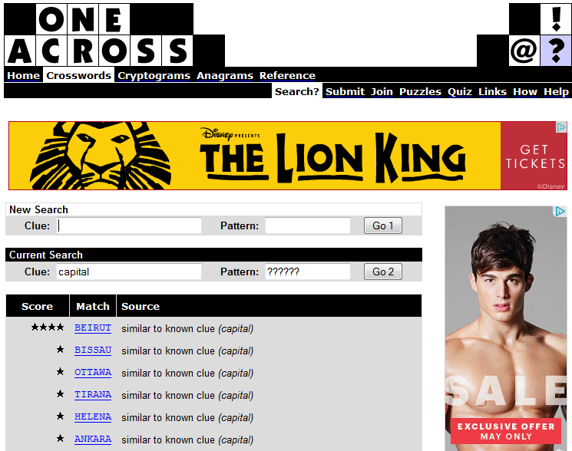

Slide 100
Dr. Fill
http://www.pri.org/stories/2014-09-24/dr-fill-vies-crossword-solving-supremacy-still-comes-short
“It’s also improving quickly. For the past three years, Dr. Fill has competed “informally” at the American Crossword Puzzle Tournament, organized by Will Shortz, the crossword editor at the New York Times. The first year, Dr. Fill came in 141st out of about 600 competitors. It did a little better the second-year; last year it was 65th. “I get a little smarter so it gets a little smarter each year — and I’m inching my way up there,” Ginsberg says.”

Slide 101
Beam Search
Based on Breadth-First Search
Expand a node based on heuristic cost
Beam size determines how many nodes to keep in memory
Not complete
Not optimal
Used for large search spaces, e.g., in machine translation

Slide 102
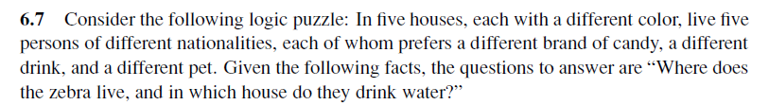
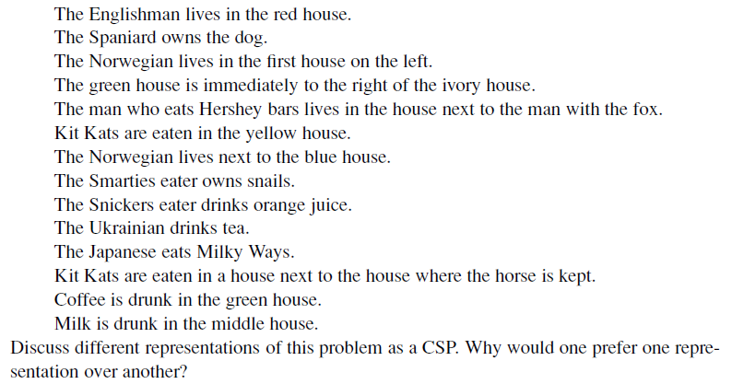

Slide 103
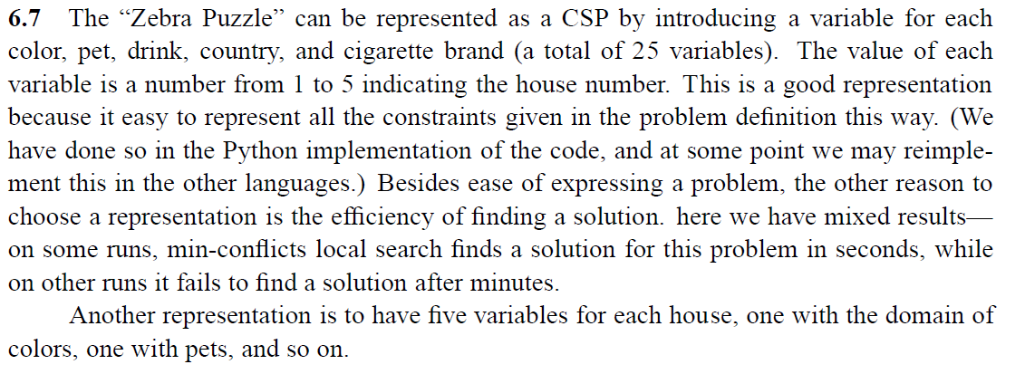

Slide 104


Linear programs: example
We make reproductions of two paintings
maximize 3x + 2y
subject to
4x + 2y ≤ 16
x + 2y ≤ 8
x + y ≤ 5
x ≥ 0
y ≥ 0
Painting 1 sells for $30, painting 2 sells for $20
Painting 1 requires 4 units of blue, 1 green, 1 red
Painting 2 requires 2 blue, 2 green, 1 red
We have 16 units blue, 8 green, 5 red

Slide 105
Solving the linear program graphically
maximize 3x + 2y
subject to
4x + 2y ≤ 16
x + 2y ≤ 8
x + y ≤ 5
x ≥ 0
y ≥ 0
8
6
4
optimal solution: x=3, y=2
2
0
2
4
6
8

Slide 106
Modified LP
maximize 3x + 2y
subject to
4x + 2y ≤ 15
x + 2y ≤ 8
x + y ≤ 5
x ≥ 0
y ≥ 0
Optimal solution: x = 2.5, y = 2.5
Solution value = 7.5 + 5 = 12.5
Half paintings?

Slide 107
Integer (linear) program
maximize 3x + 2y
subject to
4x + 2y ≤ 15
x + 2y ≤ 8
x + y ≤ 5
x ≥ 0, integer
y ≥ 0, integer
8
optimal IP solution: x=2, y=3
(objective 12)
6
4
optimal LP solution: x=2.5, y=2.5
(objective 12.5)
2
0
2
4
6
8

Slide 108
Mixed integer (linear) program
maximize 3x + 2y
subject to
4x + 2y ≤ 15
x + 2y ≤ 8
x + y ≤ 5
x ≥ 0
y ≥ 0, integer
8
optimal IP solution: x=2, y=3
(objective 12)
6
optimal LP solution: x=2.5, y=2.5
(objective 12.5)
4
2
optimal MIP solution: x=2.75, y=2
(objective 12.25)
0
2
4
6
8

Slide 109
Solving linear/integer programs
Linear programs can be solved efficiently
Simplex, ellipsoid, interior point methods…
(Mixed) integer programs are NP-hard to solve
Quite easy to model many standard NP-complete problems as integer programs (try it!)
Search type algorithms such as branch and bound
Standard packages for solving these
GNU Linear Programming Kit, CPLEX, …
LP relaxation of (M)IP: remove integrality constraints
Gives upper bound on MIP (~admissible heuristic)

Slide 110
Satisfiability as an integer program
(x₁ OR x₂ OR NOT(x₄)) AND (NOT(x₂) OR NOT(x₃)) AND …
becomes
for all x_{j}, 0 ≤ x_{j} ≤ 1, x_{j} integer (shorthand: x_{j} in {0,1})
x₁ + x₂ + (1-x₄) ≥ 1
(1-x₂) + (1-x₃) ≥ 1
…
Solving integer programs is at least as hard as satisfiability, hence NP-hard (we have reduced SAT to IP)
Try modeling other NP-hard problems as (M)IP!

Slide 111
Solving the integer program with DFS branch and bound
maximize 3x + 2y
subject to
4x + 2y ≤ 15
x + 2y ≤ 8
x + y ≤ 5
x ≥ 3
y ≥ 2
maximize 3x + 2y
subject to
4x + 2y ≤ 15
x + 2y ≤ 8
x + y ≤ 5
x ≥ 3
y ≤ 1
x ≥ 4
trick: for integer x and k, either x ≤ k
or x ≥ k+1
maximize 3x + 2y
subject to
4x + 2y ≤ 15
x + 2y ≤ 8
x + y ≤ 5
x ≥ 3
maximize 3x + 2y
subject to
4x + 2y ≤ 15
x + 2y ≤ 8
x + y ≤ 5
LP solution: x=3, y=1.5, obj = 12
LP solution: infeasible
LP solution: infeasible
maximize 3x + 2y
subject to
4x + 2y ≤ 15
x + 2y ≤ 8
x + y ≤ 5
x ≥ 3
y ≤ 1
maximize 3x + 2y
subject to
4x + 2y ≤ 15
x + 2y ≤ 8
x + y ≤ 5
x ≥ 3
y ≤ 1
x ≤ 3
maximize 3x + 2y
subject to
4x + 2y ≤ 15
x + 2y ≤ 8
x + y ≤ 5
x ≤ 2
LP solution: x=2.5, y=2.5, obj = 12.5
LP solution: x=2, y=3, obj = 12
LP solution: x=3.25, y=1, obj = 11.75
if LP solution is integral, we are done
LP solution: x=3, y=1, obj = 11

Slide 112
Again with a more fortunate choice
maximize 3x + 2y
subject to
4x + 2y ≤ 15
x + 2y ≤ 8
x + y ≤ 5
x ≥ 3
maximize 3x + 2y
subject to
4x + 2y ≤ 15
x + 2y ≤ 8
x + y ≤ 5
LP solution: x=3, y=1.5, obj = 12
done!
maximize 3x + 2y
subject to
4x + 2y ≤ 15
x + 2y ≤ 8
x + y ≤ 5
x ≤ 2
LP solution: x=2.5, y=2.5, obj = 12.5
LP solution: x=2, y=3, obj = 12

Slide 113
Summary
CSPs are a special kind of problem:
states defined by values of a fixed set of variables
goal test defined by constraints on variable values
Backtracking = depth-first search with one variable assigned per node
Variable ordering and value selection heuristics help significantly
Forward checking prevents assignments that guarantee later failure
Constraint propagation (e.g., arc consistency) does additional work to constrain values and detect inconsistencies
Iterative min-conflicts is usually effective in practice

Slide 114
AI

